Slide 1


PREMIERE BUSINESS
CONSULTATION AND
MEDIATION FIRM
Nibe Business Services
Leading provider of innovative solutions for
businesses worldwide.

Slide 2




OUR
AGENDA
01
Maximize Sales
How our financial consulting helped a startup increase revenue by 50% in one year.
Get Revenue
02
How our consultancy has helped many business to be established and get success in a short period
03
Help Startups
Startups oriented work has helped

Slide 3

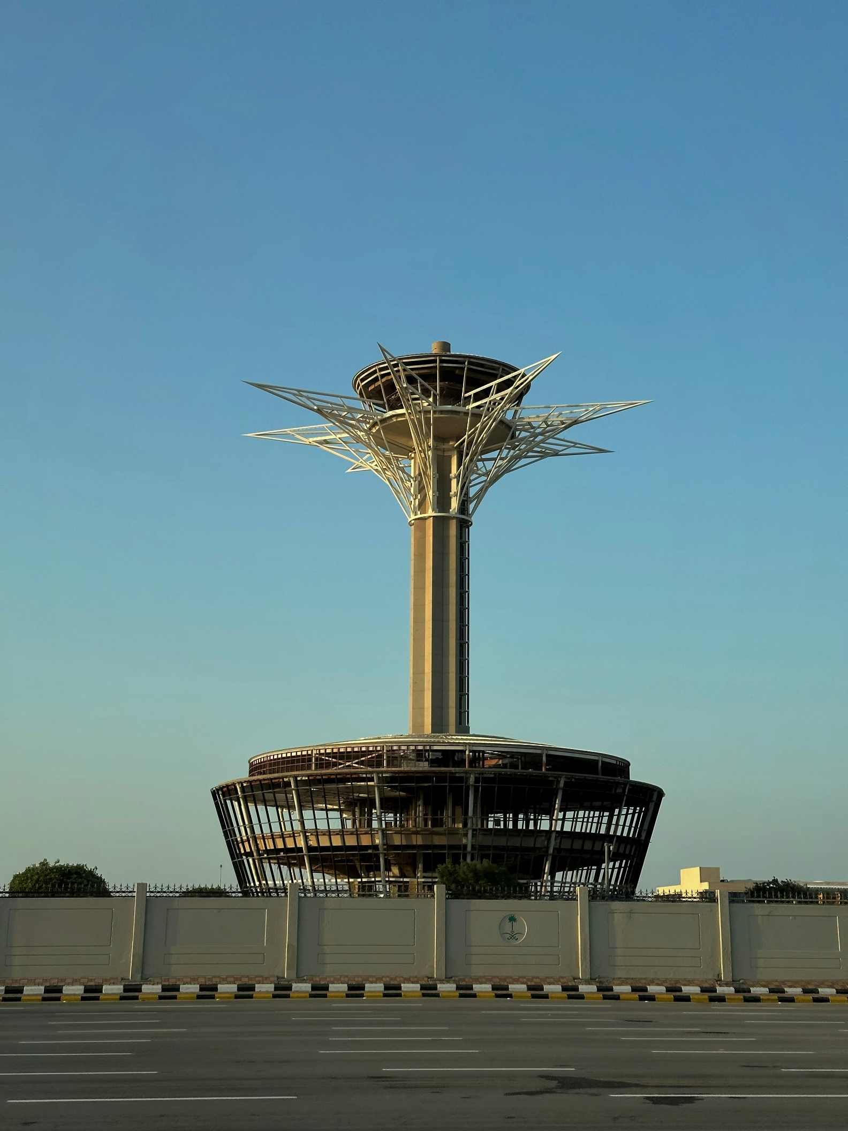


WHY CHOOSE US
As your trusted business representative and consultant in Riyadh, Saudi Arabia, Nibe simplifies complex business transactions, offering comprehensive services from valuation and negotiations to deal closure and market analysis. Our strategic consulting expertise and keen investment insight set us apart, enabling you to navigate the business landscape with confidence. We are dedicated to helping you achieve your goals by providing expert support in complex business transactions and informed decision-making. Our experienced professionals will provide strategic advice, market analysis, and identify investment opportunities to help you succeed.

Slide 4
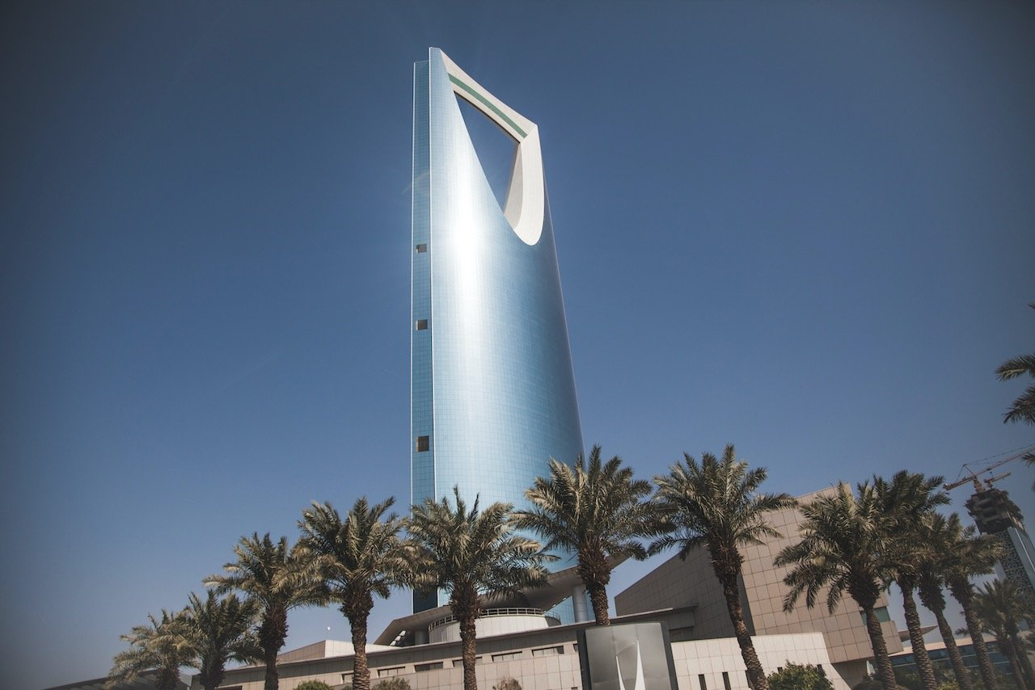
ABOUT NIBE
Nibe Business Services is a leading consulting and mediation firm specializing in helping companies establish and set up successful business partnerships in Saudi Arabia. Our experienced professionals offer a range of services, including business valuations, negotiations, and closing deals. We work closely with our clients to understand their unique needs and provide tailored solutions to achieve their goals.
MAYADER’S
SISTER COMPANY
Nibe Business Services is MAYADER’S sister company that was established in 1994 AD / 1415 AH as a group of institutions specialized in employing manpower, marketing on behalf of others, computer services and software. After 20 years of experience, Mayader Company has become one of the most prominent companies specialized in this field in the Saudi market. List of the successful employees are

Slide 5

OUR SERVICES
Business Valuations
Negotiations
Offering expert financial advice and solutions to help businesses thrive and grow.
Skillful negotiations to achieve favorable customers.
Investment Opportunities
Strategic Consultant
Identifying profitable investment options for clients.
Insightful guidance for long-term business planning
Market Analysis
Closing Deals
In-depth analysis to identify market trends and opportunities.
Efficiently closing deals for successful business transactions

Slide 6

KEY
INDUSTRIES
Retail
Finance
Healthcare
Manufacturing
Helping retailers optimize operations and enhance customer experience.
Supporting financial institutions with innovative solutions for risk management and compliance.
Providing healthcare organizations with technology solutions to improve patient care and streamline processes.
Assisting manufacturers with process optimization and supply chain management.

Slide 7
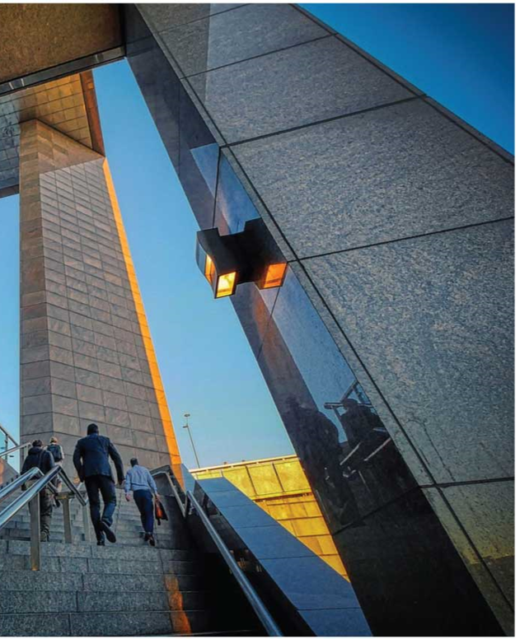
MISSION & VISION
Our mission
To provide our clients with the highest level of professional service and expertise to help them successfully enter the Saudi market.
Our vision
To be the leading consultancy and mediation firm in Saudi Arabia, recognized for our expertise, integrity, and commitment to client success.

Slide 8

OUR
VALUE
Networking and
Relationships
Advisory
We provide go to market advisory and best legal and logistic opinions
At Nibe we provide highly professional network and business understanding to key decision makers in many industries
Business Intelligence
Return on Investment
We bring added value to our partners through business intelligence and market understanding
We provide our partners with value for money consultation and and the best return on investment for go to market decisions

Slide 9






WHY NIBE?
Relationship
Value for money
Excellence
Integrity
Provide our partners with long term relationship utilizing our 40 years plus of experience
We provide value for money for our partners and looking for both partners best business model.
We provide excellence and high professionalism in our services
All our work in done with integrity and confidentiality.

Slide 10
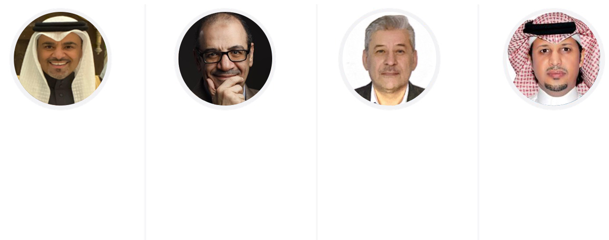
OUR
TEAM
ADBULLAH M. ALZEHAIRI
ABDULHAI MEGDAD
MOHAMMAD ABDUL JABBAR
MESHAL ALAMRI
CEO Profound consultant with more than 20 years as VP in private sector but not limited to institute tourism authority, Insurance Company and more .
CONSULTANT With more than 25 years of experience in marketing and relationship management more specifically in business development
CHIEF BUSINESS DEVELOPMENT OFFICER (MENA) Business development
consultant for more than 25 years of experience in business consultancy
CHIEF PARTNERSHIP OFFICER
20 Years of consulting experience in both government and privet sector, specifically in the area of quality management and control

Slide 11
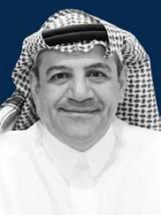
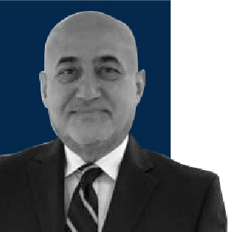
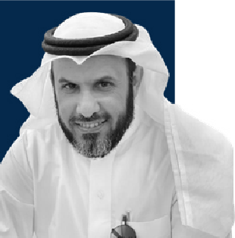
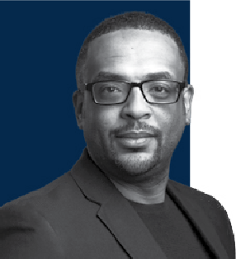
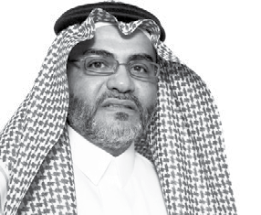
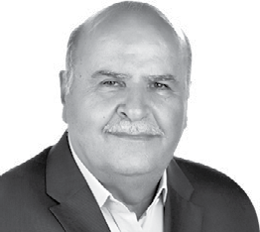
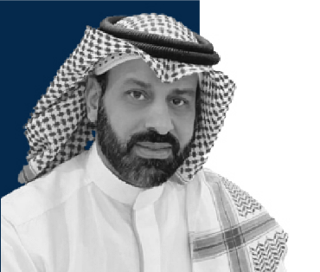

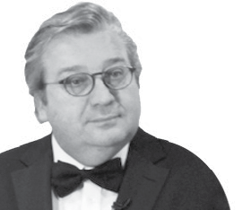
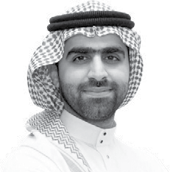
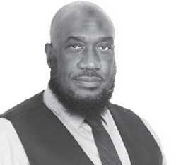
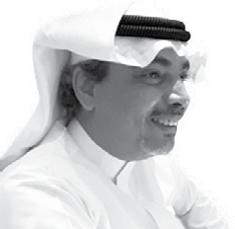
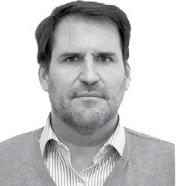
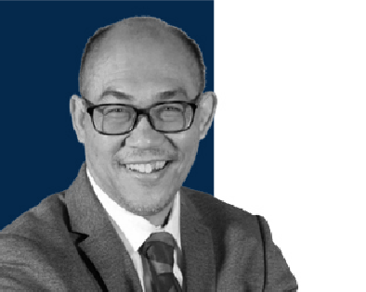
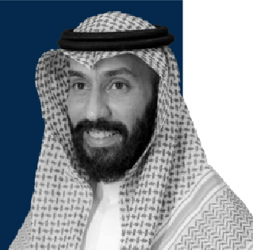
MEGA GROUP
ADVISORY BOARD
DR. ABDULHAI MEGDAD
DR. SAAD D KIRYAKOS
DR. RIYADH T. ALMATRAFI
DR. MOHAMMED JADKAREEM
DR. HAMMOUD ALJAMALI
MR. MOHAMAD FAYEZ TAMIMI
DR. HMOUD ALSHAMRI
MR. FERNANDO SALVETTI
DR. HISHAM MALAK
MR. ISMAIL ABDURRAHMAN
MR. ABDEL LATIF BA ISSA
MR. MANUEL BELLSOLELL
MR. RAYMOND PHOON
MR. NAIF AL-BUTTI

Slide 12
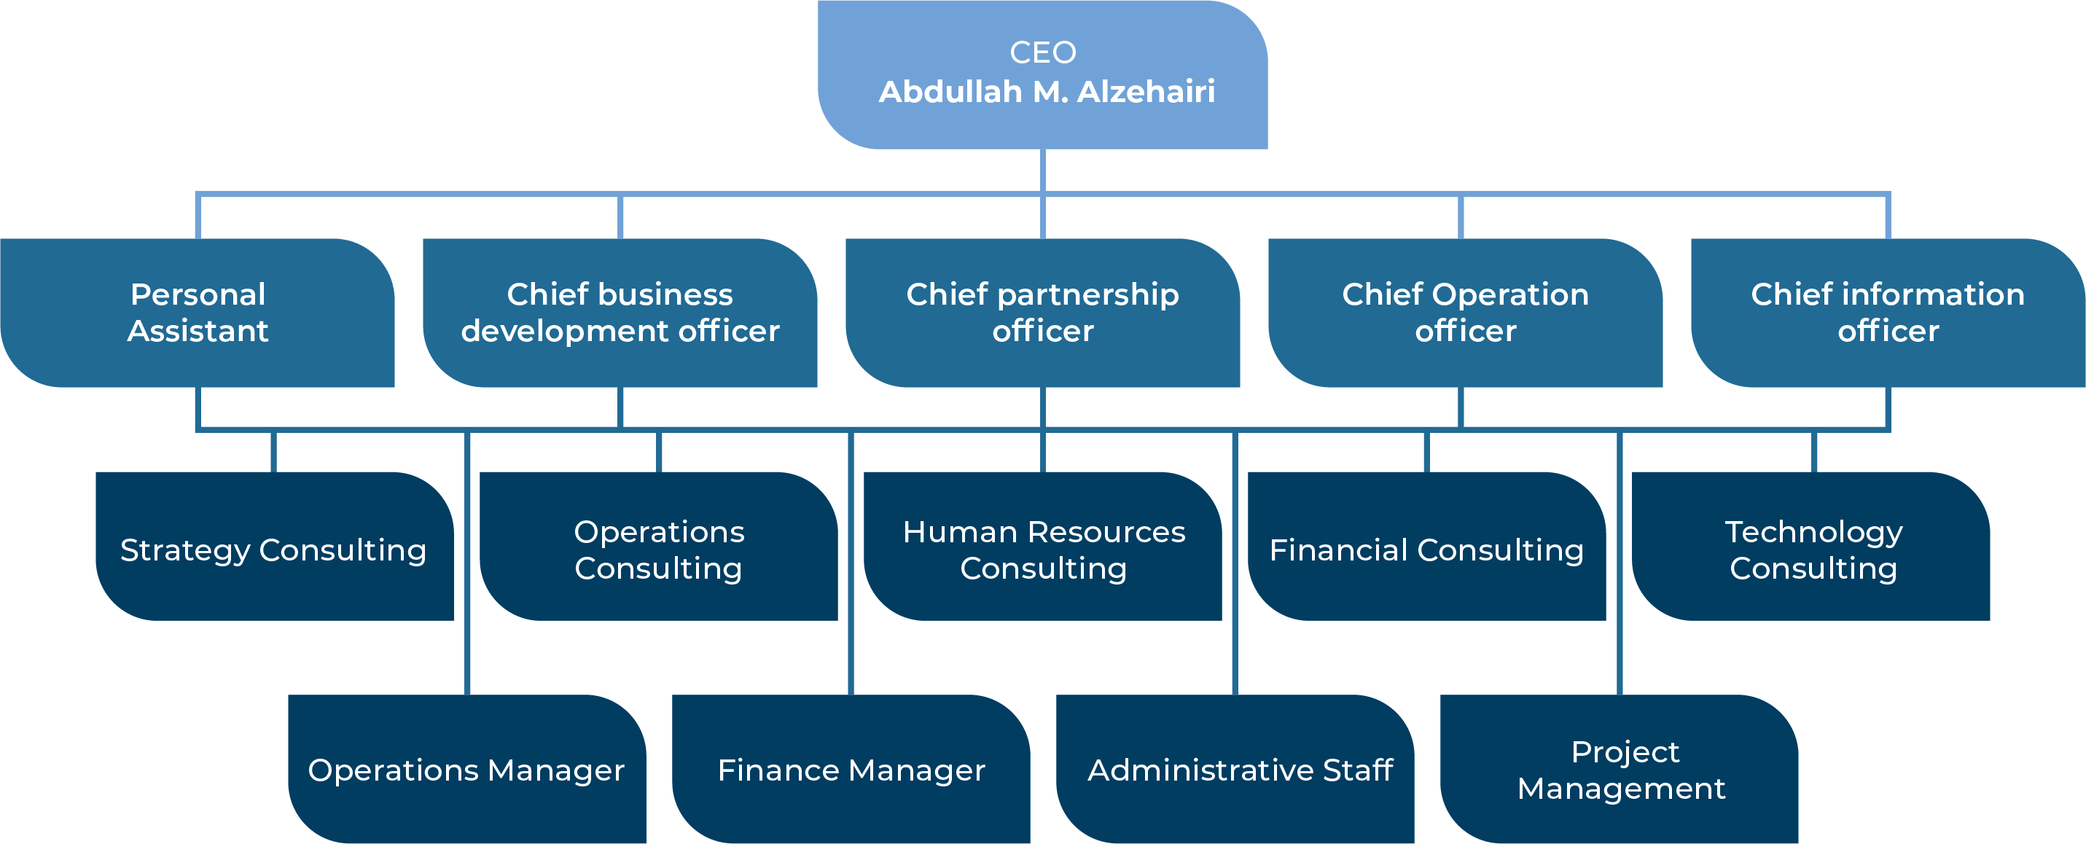
ORGANIZATIONAL
STRUCTURE

Slide 13













DEVELOPING A BUSINESS WHICH IS SCALABLE AND HAVE SUSTAINABLE COMPETITIVE ADVANTAGES
Our strategic approach empowers organizations from inside & outside
Business outside
Market Forecasts
Market Risk assessment
Corporate Growth Strategy
Customer Experience
Market Intelligence
Organization al inside
Oraganization Structure
Policy & Procedures
Automation &
Digital Transformation
Organizational Operational Synergies
Eﬃcient &
Eﬀective Governance
Human Capital Transformation

Slide 14





OUR INTERNATIONAL PARTNERSHIPS
Develop Unique Digital Products to Automate the Activities of Government Agencies and Organizations in the Field of Transport and, Security Surveillance and Public Safety (Safe and Smart Cities) Powered by AI.
VizorLabs, a leading provider of advanced video analytics systems leveraging AI and neural networks to tackle various challenges faced by industries catering to diverse industrial needs. Their cutting-edge technology solutions are meticulously crafted to enhance the safety, efficiency, and productivity of your operations.
Schneestern Designs and Builds Facilities for Action Sports, Both in Winter and Summer. Accordingly, Our Product Range Is Divided into Different Focuses in the Area.
Wakeparx strives to constantly improve construction, operation, safety and entertainment value of our wakeboarding systems.
Houseboats make High-Quality Innovative floating moving houses, offices, restaurants, & touristic villages adjusted for different sea & lakes conditions. State of art designed in Denmark & made in Russia.

Slide 15























OUR LOCAL PARTNERSHIPS

Slide 16


CLIENT
TESTIMONIALS
Muhammad Saleh
“Nibe Business Services provided us with invaluable financial advice that significantly contributed to our company's success."
Ahmad Al Bakir
"The consultancy solutions implemented by Nibe Business Services streamlined our operations and improved overall efficiency."
Hamid Al-Sheikh
"The marketing strategies developed by Nibe Business Services helped us reach new customers and achieve remarkable growth."

Slide 17
CONCLUSION
In conclusion, our company's business consultancy services are poised for continued success and growth. Through a thorough examination of our strengths and opportunities, we have reaffirmed our dedication to excellence and client satisfaction. By fostering open communication, collaboration, and ongoing professional development, we are well-equipped to refine our offerings and explore innovative solutions. With a commitment to continuous improvement, we will solidify our position as a premier provider in the industry, delivering top-notch consultancy services to our valued clients. Thank you for your dedication and contributions to our collective success.
In addition to our commitment to excellence, our team's passion for delivering outstanding consultancy services is deeply ingrained in our organizational culture. Each team member brings a wealth of knowledge, experience, and dedication to the table, creating a dynamic environment where innovation thrives. Our shared mission to exceed client expectations drives us to continually push the boundaries of what's possible, seeking out new opportunities for growth and improvement. One of the key factors that sets our consultancy services apart is our unwavering dedication to understanding and addressing the unique needs of each client. We recognize that every business is different, with its own set of challenges, goals, and aspirations. As such, we approach each project with a tailored mindset, taking the time to listen, analyze, and strategize in collaboration with our clients. By building strong, trust-based relationships, we ensure that our solutions are not only effective but also sustainable in the long run. Moreover, our team's passion for continuous learning and development fuels our ability to stay ahead of the curve in an ever-evolving business landscape. We actively seek out opportunities to expand our knowledge, whether through industry conferences, training programs, or collaborative projects with other experts in the field. This commitment to ongoing professional growth not only enhances our individual capabilities but also strengthens the collective expertise of our team.

Slide 18

THANK
YOU!
info@nibe.sa
+966-50-44-88547
3845 Al Khaznz, Ishbiliyah District,
6302, Riyadh 13225

